Slide 1
SM
Personal Software Process
for Engineers: Part I
Tutorial: Using PSP0

Slide 2
Tutorial Objectives
After this tutorial, you will
  understand the PSP0 process
  know how to use PSP0 process scripts and forms
  be prepared to use PSP0 for program 1

Slide 3
PSP0 Process
PSP0 is a simple, defined, personal process.
  Make a plan.
  Use your current design and development methods to produce a small program.
  Gather time and defect data on your work.
  Prepare a summary report.

Slide 4
PSP0 Objective
The objective for PSP0 is to
  demonstrate the use of a defined process in writing small programs
  incorporate basic measurements in the software development process
  require minimal changes to your personal practices

Slide 5
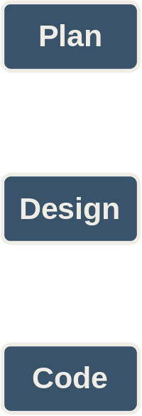
PSP0 Process Phases -1
PSP0 has six phases.
Planning – produces a plan for developing the program defined by the requirements.
Design – produces a design specification for the program defined by the requirements.
Coding – transforms the design specification into programming language statements.

Slide 6
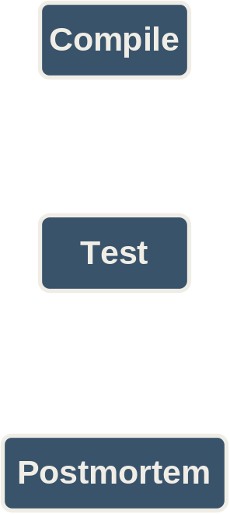
PSP0 Process Phases -2
Compile – translates the programming language statements into executable code.
Test – verifies that the executable code satisfies the requirements.
Postmortem – summarizes and analyzes the project data.

Slide 7
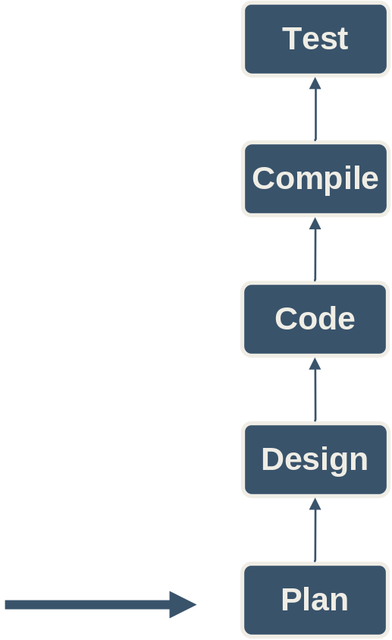
Phase Order
Phase order is determined by the dependencies between phases.
  You can’t test the code before it’s compiled.
  You can’t compile the code before it’s written.
  You can’t use the design if it’s produced after the code is written.
  There’s no reason to make a plan after you’re done.
You should start here

Slide 8
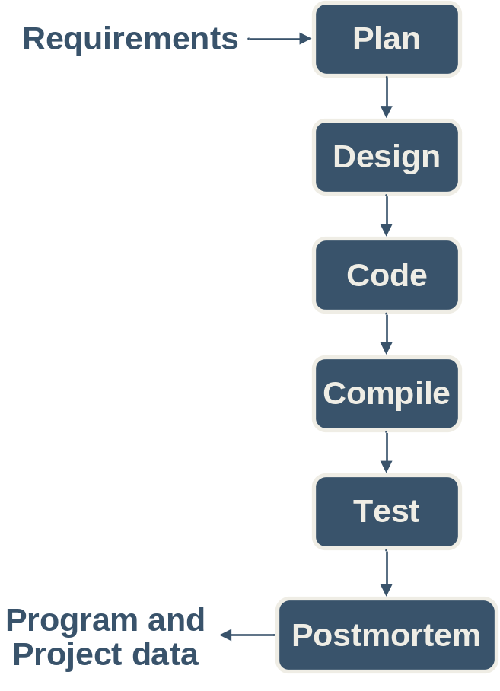
Process Flow
For programs that are small or well understood, execute the phases in order.
Product a plan.
Design all modules.
Code all modules.
Compile the coded program.
Summarize the project data during the postmortem.

Slide 9
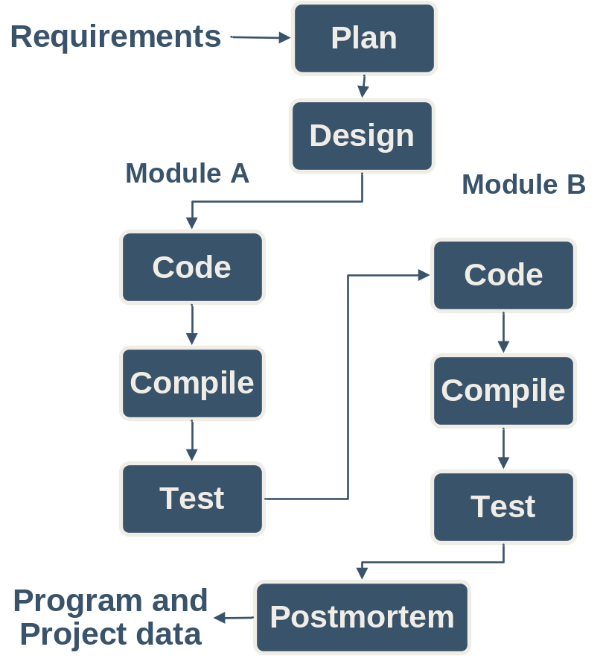
Cyclic Process Flow -1
Some programs may require an iterative approach.
In this example the design is completed in one step.
Two modules are identified during the design, modules A and B.
Then each module is separately coded, compiled, and tested.
This example uses the PSP0 phases and two cycles of code-compile-test.

Slide 10
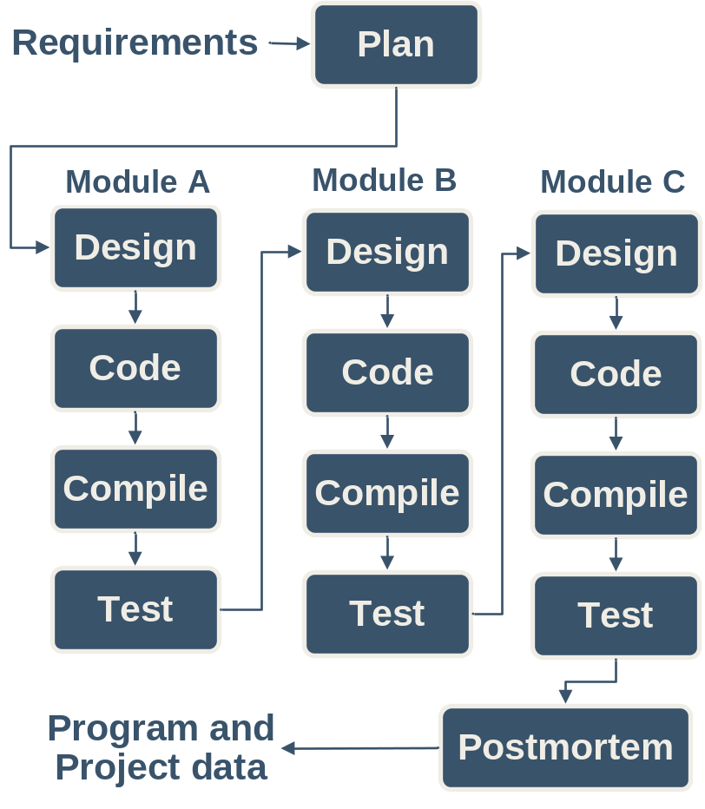
Cyclic Process Flow -2
There can be more than two cycles and cycles can also include the design phase as in this example.
Note that each cycle is focused on producing part of the program, e.g. Module A, Module B, Module C.
Part size is a key factor for determining cycles.
  a line of code is too small
  a program may be too large
One or more classes, methods, procedures, functions, etc. are the appropriate size part for a cycle.

Slide 11
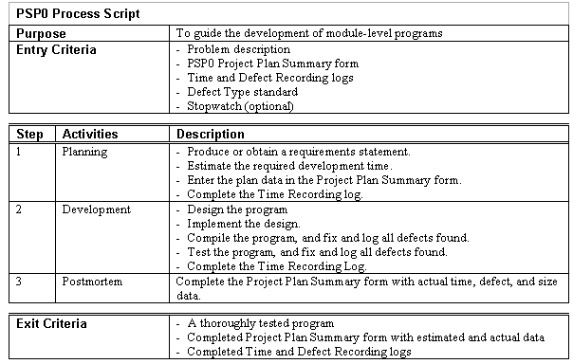
Process Scripts
Process scripts provide “expert-level” guidance on how to use the process.
They are one or two pages long.
They describe the
  Purpose
  Entry criteria
  General guidelines
  Steps
  Exit criteria

Slide 12
The PSP0 Scripts -1
Planning: Estimate the development time.
Development: Develop the product using your current methods.
Postmortem: Complete the project plan summary with the time spent and defects found and injected in each phase.

Slide 13
The PSP0 Scripts -2
Design: Design the program using your current design methods.
Coding: Implement the program.
Compile: Compile until defect-free.
Test: Test the program and fix all defects.
Record defects in the defect log and time per phase in the time log.

Slide 14
Using Process Scripts
Process scripts guide you through the process.
You should
  check the entry criteria before starting a phase
  record the phase start time
  perform the phase steps and instructions
  record defects as they are found and corrected
  check the exit criteria before ending a phase
  record the phase end time
  go to the next phase
Force yourself to use this paradigm until it becomes a habit.

Slide 15
PSP0 Measures and Forms
PSP0 measures
  Time – track time in phase
  Defects – record defects as they are found and fixed
PSP0 has four forms
  PSP0 Project Plan Summary – summarizes planned and actual time and defects by phase
  PSP0 Time Recording Log – used to record time
  PSP0 Defect Recording Log – used to record defects
  PSP0 Defect Type Standard – used to define standard defect types

Slide 16
PSP Student Workbook
The PSP Student Workbook provides support for the PSP.
  scripts
  forms
  measures
  calculations
  planning
  tracking
  quality management
  analysis
  historical data
  access to class materials
It also provides support for post-course use of the PSP.

Slide 17
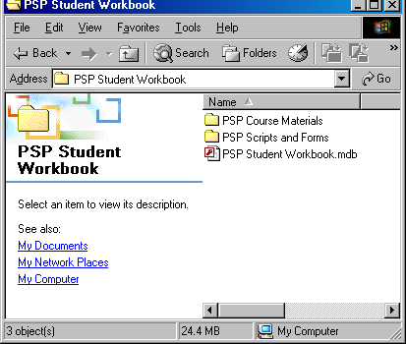
Installing the PSP Student Workbook
Create a folder to hold the contents of the student CD.
Copy the contents of the CD to this folder.
Contents
  PSP Course Materials
  PSP Scripts and Forms
  PSP Student Workbook

Slide 18
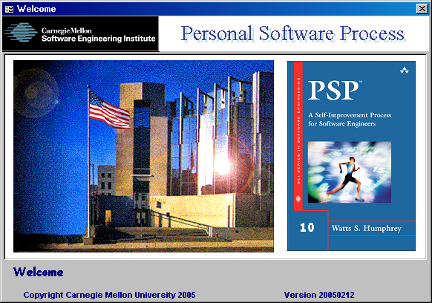
Open the PSP Student Workbook
Open the file PSP Student Workbook.
The welcome form will open followed by the student profile.

Slide 19
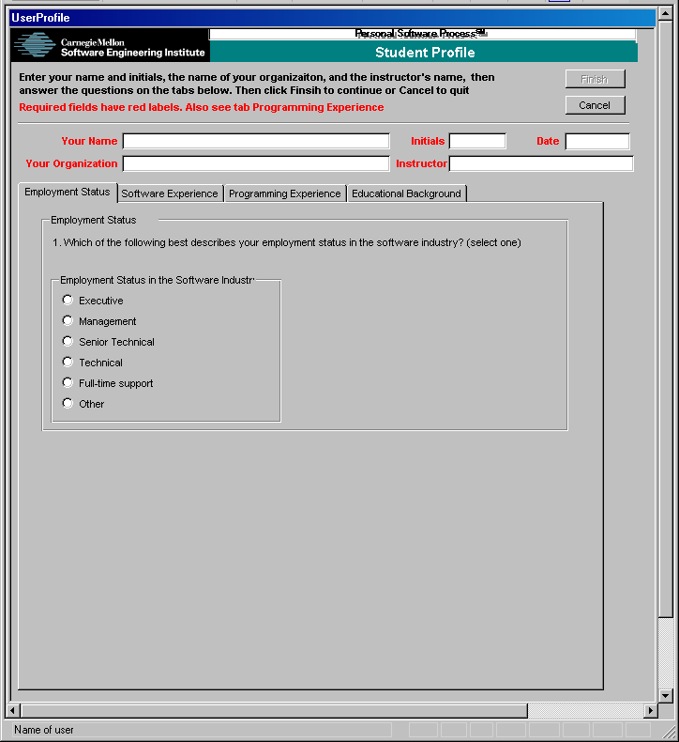
Complete the Student Profile
Enter the following
  name
  initials
  date
  name of your organization or company
  name of the lead instructor
Answer the questions under each tab.
  employment status
  software experience
  programming experience
  educational background
Click Finish.

Slide 20
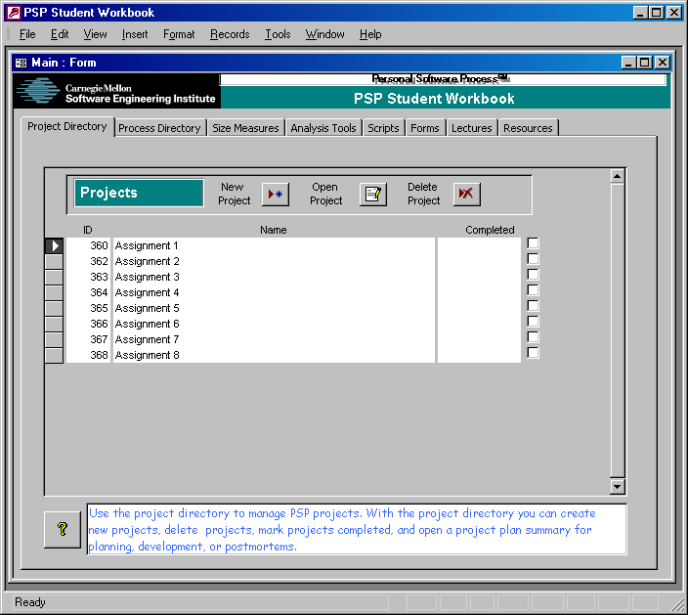
Opening a PSP Project
Select the first project, Assignment 1.
Click Open Project.
! Do NOT open a project until you have completed the previous project.

Slide 21
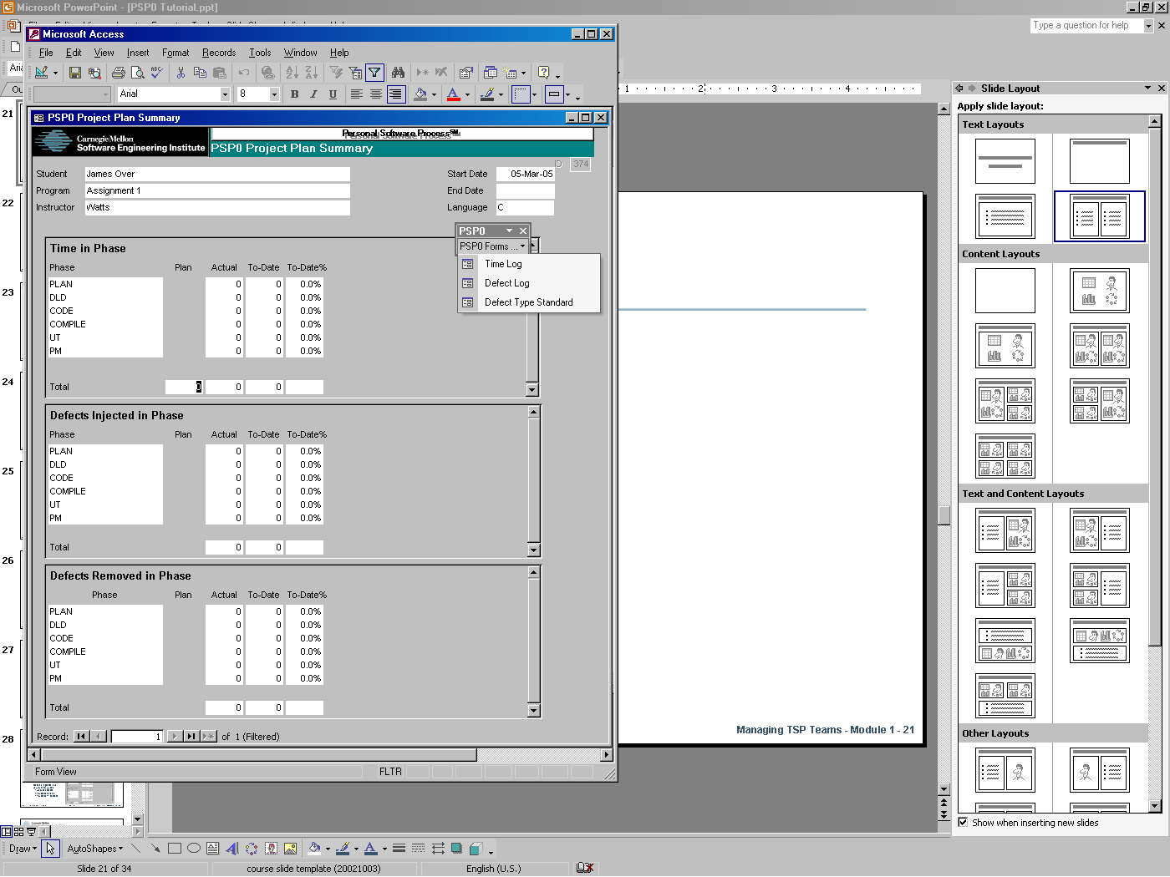
PSP0 Forms -1
This is the PSP0 Project Plan Summary.
To open the other PSP0 forms click PSP0 Forms… on the PSP0 menu.
Select the form to open
  Time Log
  Defect Log
  Defect Type Standard

Slide 22
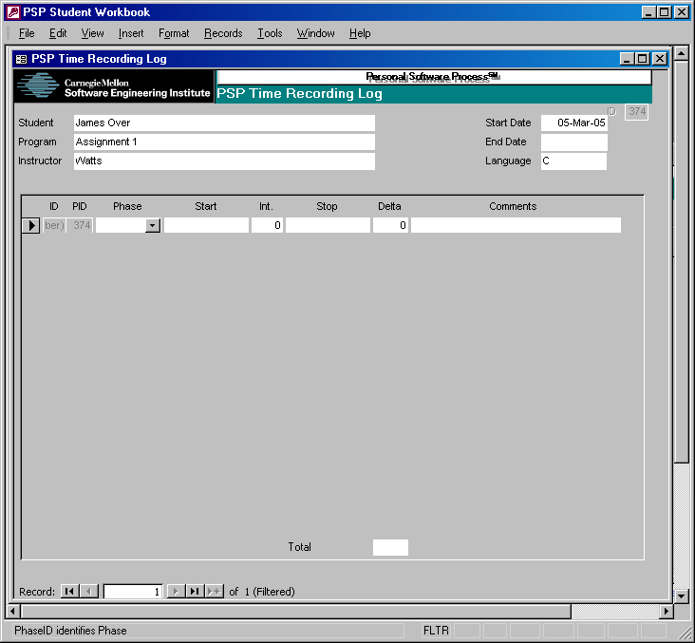
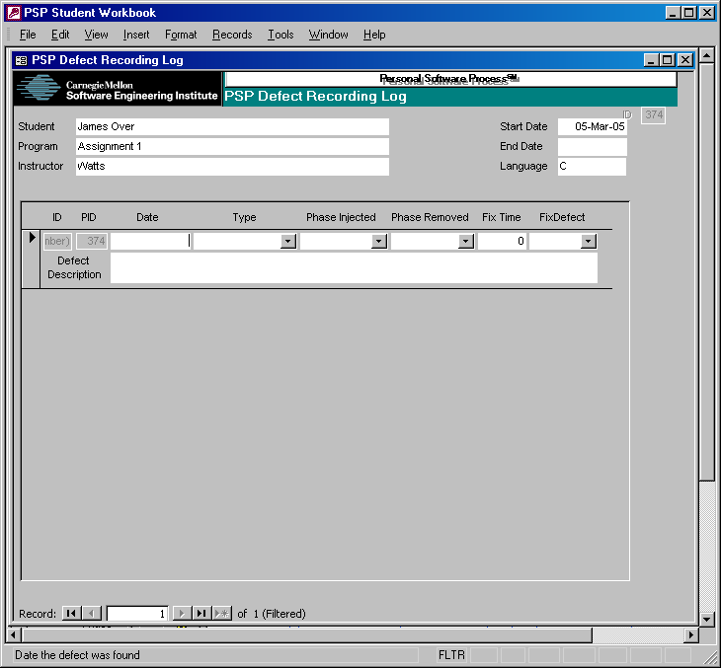
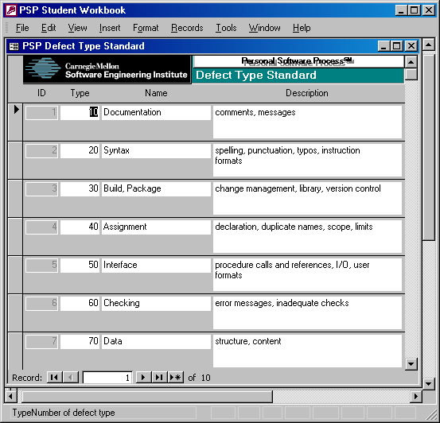
PSP0 Forms -2

Slide 23
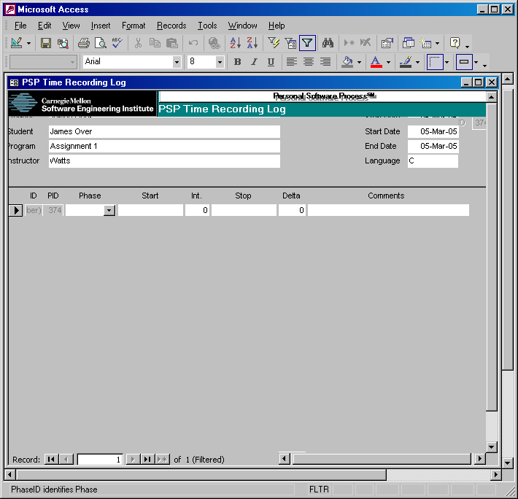
PSP0 Time Recording Log -1
Phase: Select the phase on which you were working.
Start: Enter the date and time you started working. Double click to enter the current date and time.
Int.: Enter any interruption time in minutes.

Slide 24
PSP0 Time Recording Log -2
Stop: Enter the date and time you stop working. Double click to enter the current date and time.
Delta Time: The elapsed time is calculated automatically.
Comments: Describe an interruption, the task you were doing or anything else that significantly affects your work

Slide 25
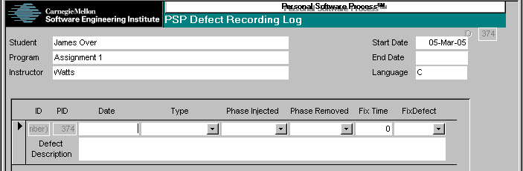
Defect Recording Log -1
Type: Select the defect type
Date: Enter the date the defect was found. Double-click to enter the current date.
Phase Injected: Select or enter the phase during which you judge the defect was injected.
Phase Removed: Enter the phase during which you found and fixed the defect.

Slide 26
Defect Recording Log -2
Fix time: Enter the time that you took both to find and fix the defect. You may time it exactly, or use your best judgment.
Fix defect: If this defect was injected while fixing another defect, enter the number of that defect.
Description: Enter explanation of what the defect was (not the symptom, but the defect!).

Slide 27
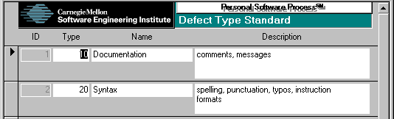
Defect Type Standard
The defect type standard provides a general set of defect categories.
While you may add items or replace this standard with your own, it is generally wise to stick with these simple definitions until you have data to guide your changes.

Slide 28
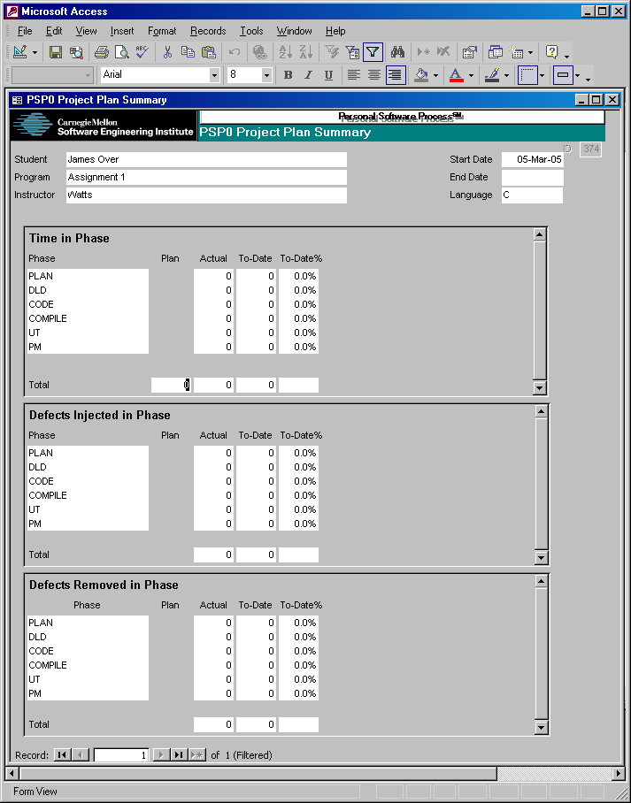
PSP0 Project Plan Summary
Enter your best estimate of the total time that the development will take.
The remaining items are calculated automatically.
Time in phase
  Actual time
  To Date time
  To Date % time
Defects injected and removed in phase
  Actual defects
  To Date defects
  To Date % defects

Slide 29
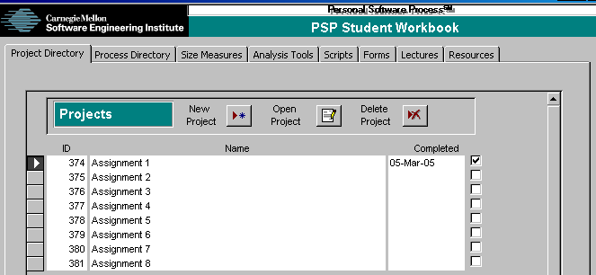
Completing a PSP Project
Select the project, e.g. Assignment 1.
Enter a date in the completed fields or click the completed checkbox to enter today’s date.

Slide 30
Measurement Hints
Gather and record data on your process as you work, not afterwards. If you forget, promptly make your best guess.
Be precise and accurate.
  Track time in minutes.
  Count every defect.
You will be using your own data to manage your process; gather data that is worthy of your trust.

Slide 31
Defect Fix Time
Defect fix time is often misunderstood.
It is the time taken both to find and fix the defect.
Example
8:05 run compiler on p1a.c, “line 23 - type mismatch”
8:06 run editor on p1a.c
8:15 change declaration on line 6 from integer to real
8:16 run compiler on p1a.c, “no errors”
Q: What is the defect fix time?
A: 10 minutes

Slide 32
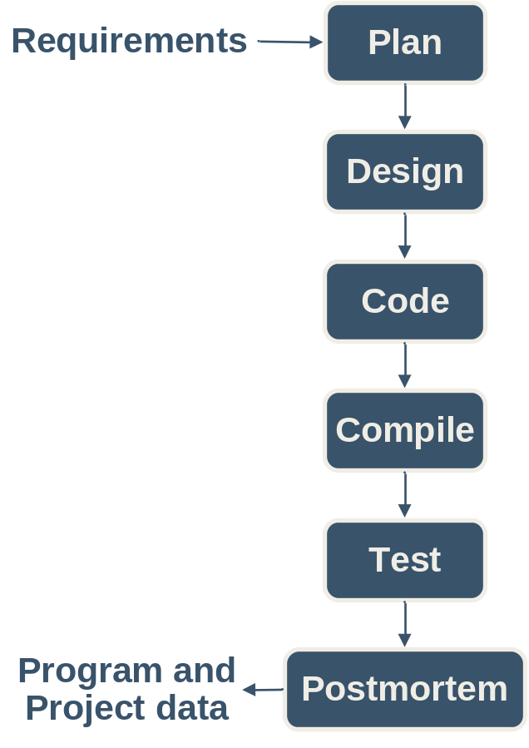
Defect Phase Injected
The injected phase for a defect depends on the phase the program is in.
Example:
Tom finds a major logic error in his program during test. He has to redesign and code part of his program.
Q: What phase is Tom’s program in?
A: Test
Tom finds a defect in the new code he has written.
Q: In what PSP phase was the defect injected?
A: Test

Slide 33

Measurement in the Cyclic Process
Considerations
  Include a program part identifier in the notes field on time log entries.
  Add a similar annotation to defect log entries.
  Use “Test” as the phase removed when defects are found in a previously tested part.
Example
Tom finds and fixes an interface error in part A of his program while coding part B.
Q: In what PSP phase was this defect removed?
A: Test

Slide 34
Messages to Remember
In using PSP0, your principal objective is to learn to gather and report accurate and complete data on your work.
Once you have completed this course, you will know how to adjust and extend the PSP to meet your future needs.
Until then, make your best effort to follow the PSP process scripts and instructions.

